Slide 1
8. User account and permissions

Slide 2
Contents
Users account
Introduction to user and group
Add, modify, and delete user account
Scripting
Permissions
Types
Changing permissions
Default permissions
Special permissions
Notes:
In this session, we will discuss about who can use what in the system. The first fact is who. In Linux we manage users by accounts and groups of account. On these objects, we can do standard operations such as add, modify and delete objects. We can do it by shell scripting to get the work finished faster
Most of resources of the system are managed by Linux as files. To define who can access what, Linux has a permission information in each inode. We will learn what are the permissions, who has which permission, how to modify this information

Slide 3
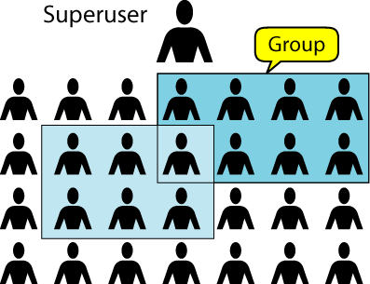
Basics of user accounts in Linux
Types of user account
Notion of group
Storage of user account
/etc/passwd
/etc/group
/etc/shadow
Notes:
In Linux, there are 2 types of users account. The first type is root or superuser, who has all permissions on all objects in the system. Object’s permission setting is not effective for this kind of user. The second type of users are normal users. They can access object that they have permissions. By default, an user has a login name, password, home directory and environmental information.
These information are stored in several system file: /etc/passwd, /etc/group, /etc/shadow.
Account information is in /etc/passwd. Each line corresponds to an user and contents basic information such and login name, home directory, shell and …
The passwd is encrypted and stored in /etc/shadow.
To manage users easier, users are grouped in group.
List of groups and members are stored in /etc/group.
To create, modify or delete users and group, we have to change the contents of this files.

Slide 4
User and group action
Creating user
Modifying user properties
Deleting user
Adding user into existing group
Creating group
Removing group
Scripting actions
Notes:
We can create users using useradd command
For modifying user properties, the command usermod is used
Deleting user is done bny command userdell
The command Gpassword add user into existing group
Creating group: groupadd
Removing group: groupdell
Scripting actions

Slide 5
/etc/passwd
Username:password:UID:GID:Info:Home:Shell
Username: It is used when user logs in. It should be between 1 and 32 characters in length.
Password: An x character indicates that encrypted password is stored in /etc/shadow file.
User ID (UID): Each user must be assigned a user ID (UID). UID 0 (zero) is reserved for root and UIDs 1-99 are reserved for other predefined accounts. Further UID 100-999 are reserved by system for administrative and system accounts/groups.
Group ID (GID): The primary group ID (stored in /etc/group file)
User ID Info: The comment field. It allow you to add extra information about the users such as user's full name, phone number etc. This field use by finger command.
Home directory: The absolute path to the directory the user will be in when they log in. If this directory does not exists then users directory becomes /
Command/shell: The absolute path of a command or shell (/bin/bash). Typically, this is a shell. Please note that it does not have to be a shell.

Slide 6
/etc/shadow
User:Pwd:Last pwd change :Minimum:Maximum:Warn:Inactive :Expire
User name : It is your login name
Password: It your encrypted password. The password should be minimum 6-8 characters long including special characters/digits
Last password change (lastchanged): Days since Jan 1, 1970 that password was last changed
Minimum: The minimum number of days required between password changes i.e. the number of days left before the user is allowed to change his/her password
Maximum: The maximum number of days the password is valid (after that user is forced to change his/her password)
Warn : The number of days before password is to expire that user is warned that his/her password must be changed
Inactive : The number of days after password expires that account is disabled
Expire : days since Jan 1, 1970 that account is disabled i.e. an absolute date specifying when the login may no longer be used

Slide 7
/etc/group
group_name:Password:Group ID (GID): Group List
group_name: It is the name of group. If you run ls -l command, you will see this name printed in the group field.
Password: Generally password is not used, hence it is empty/blank. It can store encrypted password. This is useful to implement privileged groups. X means passwd is stored in /etc/gshadow
Group ID (GID): Each user must be assigned a group ID. You can see this number in your /etc/passwd file.
Group List: It is a list of user names of users who are members of the group. The user names, must be separated by commas.

Slide 8
/etc/gshadow
Group name — The name of the group. Used by various utility programs as a human-readable identifier for the group.
Encrypted password — The encrypted password for the group. If set, non-members of the group can join the group by typing the password for that group using the newgrp command. If the value of this field is !, then no user is allowed to access the group using the newgrp command. A value of !! is treated the same as a value of ! — however, it also indicates that a password has never been set before. If the value is null, only group members can log into the group.
Group administrators — Group members listed here (in a comma delimited list) can add or remove group members using the gpasswd command.
Group members — Group members listed here (in a comma delimited list) are regular, non-administrative members of the group.

Slide 9
The user environment
Default configuration for all user
/etc/initrc
/etc/profile
/etc/bashrc
Starting configuration for user
/etc/.bashrc
Changing shell
bashrc
tcsh
Changing home directory

Slide 10
/etc/inputrc
Inputrc deals with the mapping of the keyboard for certain situations. This file is the start-up file used by readline, the input related library used by bash and most other shells.
For more information see info bash—Node: Readline Init file as well as info readline. There is a lot that can be done with this one rc file.
Global values are set in /etc/inputrc. Personal user values are set in ~/.inputrc. The ~/.inputrc file will override the global settings file. A later page sets up Bash to use /etc/inputrc if there is no .inputrc for a user when /etc/profile is read (usually at login). If you want your system to use both, or don't want global keyboard handling, it is a good idea to place a default .inputrc into the /etc/skel directory for use with new users.
Below is a base /etc/inputrc along with comments to explain what the various options do. Note that comments can not be on the same line as commands.
If you will create an .inputrc in /etc/skel using the command below, change the command's output to /etc/skel/.inputrc and be sure to check/set permissions afterward. Then you can just copy that file to /etc/inputrc and the home directory of any user already existing in the system, including root, that needs a private version of the file. Be sure to use the -p parameter of cp to maintain permissions and be sure to change owner and group appropriately.

Slide 11
Tools
useradd/usermod/userdel
passwd
groupadd/groupmod/groupdel
gpasswd
sg/newgrp
su
users/groups
id

Slide 12
Permissions
4 types of access
Read, write, execute and none
3 types of users
Owner, group and other
Presentation of permissions
rwx rwx rwx
Notes:
Permissions are information defining who can use what in the system. We have 4 type of permissions on each object. They are : read, write, execute and none. For files, the meaning of the permissions is clear. For directories, it is a bit confused. To read the information about the directory (i.e information in the inode block corespond), we need read permission. To read the information in the directory’s data, we need an execute permission. To change the information in the inode and in the file, we need write and execute information.
Permissions are set for 3 sets of users. The first set is the user owning the object. The second are users in the group-owner. The rest are in the other group.
Permissions then are presented in 3 group of 3 bit. Each group content 3 bit corresponding 3 permissions for each set of users. 3 groups are for user, group and other group of users.

Slide 13
Tools
To change who uses the object
chown
chgrp
chmod [ugo,a][=+-][rwx] filename
chmod XXX file name

Slide 14
Permission manipulation
Changing permissions
Using ugo notation
Using code
Recursion
Permissions of a newly created file
umask
Notes:
To change the permissions, we can use chmod command. The command specifies the permissions by two ways:
Using ugo notation:
Chmod ugo[+-=]rwx where
U:user
G: group
O: Other
R: read
W: Write
X: execute
+: add permissions
-: remove permissions
=: set permissions
In another way, we can specify permissions using 3 octal numbers correspond to 3 groups of 3 bits permissions
Newlly created files are set with system default permission. This default permission is set by the command umask

Slide 15
Using umask
By default, permission for file is 666, for directory is 777
The newly created file permission is default permission substract umask
Umask is used to removed access to new object by default
Normally, umask is defined in /etc/bashrc or /etc/profile

Slide 16
Special permissions
Sticky bit
Suid bit
Sgid bit
Setting special permissions bits
Notes:
In reality, each permission bit group content 4 bit. The forth bit of each group mean different activities
For the user bits, it is suid bit. If this bit=1 and x=1, the file can be executed with owner permissions, not executer permissions
For the group bits, it is suid bit. If this bit=1 and x=1, the file can be executed with group-owner permissions, not executer permissions .
For the other bits, it is stickybit. If this bit=1 for files, that means the file can stay resident in memory. For directories, it means that files can be read, write, modified in the directory, but not deleted.

Slide 17
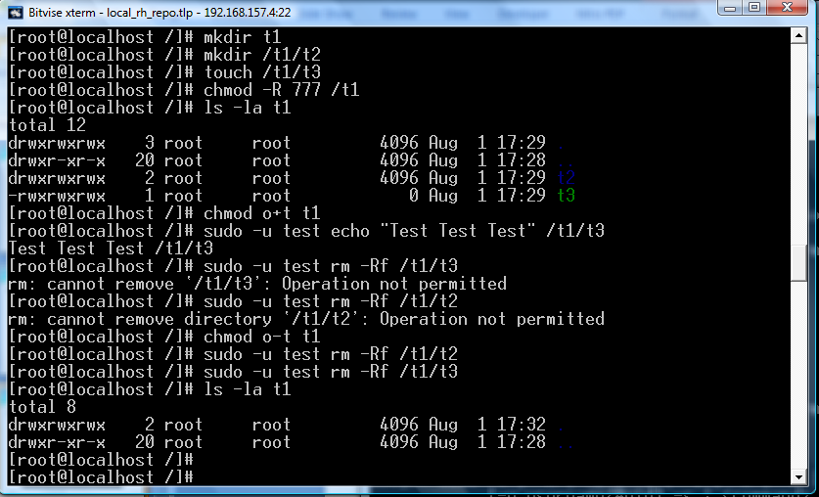
Sticky bit example

Slide 18
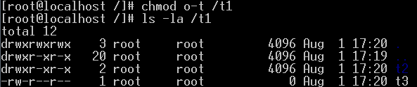
Sticky bit example

Slide 19
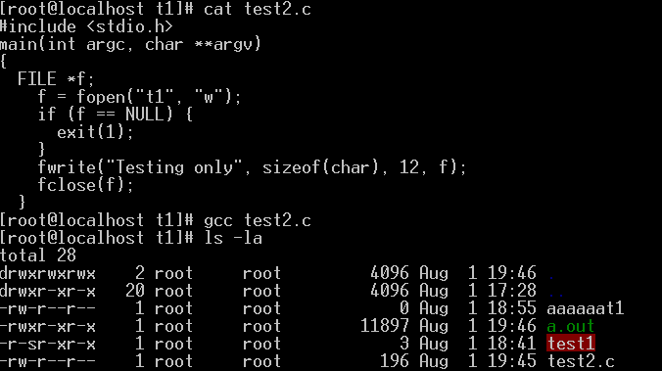
Suid bit-example

Slide 20
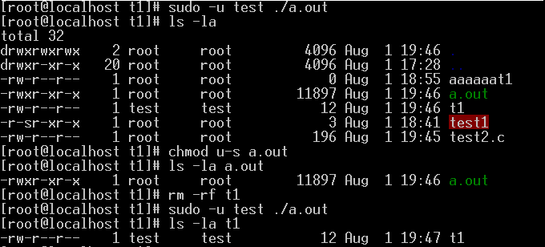
Suid bit-example

Slide 21
Summary
Users account
Introduction to user and group
Add, modify, and delete user account
Scripting
Permissions
Types
Changing permissions
Default permissions
Special permissions

